Slide 1

Department of Computer Science and Engineering
VNIT Nagpur
Document Verification of an Individual using Blockchain
Group 5
Abhishek Yadav - BT18CSE106
Vanshika Jain - BT18CSE107
Suyash Khade - BT18CSE117
Hardik - BT18CSE118
Shraddha Bhagawat - BT18CSE123
Under the guidance of
Prof. Manish P. Kurhekar
Notes:
Intro
Background - Data preserving and sxplorecurity
Blockchain tech
Applications - listIntro
Background - Data preserving and security
Blockchain tech
Applications - list
Apps explored
References
Intro
Background - Data preserving and security
Blockchain tech
Applications - list
Apps explored
References
Intro
Background - Data preserving and security
Blockchain tech
Applications - list
Apps explored
References
Apps explored
References

Slide 2

Recap
The proposed solution was to create a blockchain based application where organizations have the privilege to write the information on to the blockchain, which can be used to verify the authenticity of documents.
We had explored working of hyperledger and developed a basic application on it.
We had a structure and workflow in mind, which we have progressed upon.
Notes:
In the current data age, a lot of data is generated each day and securely storing and sharing it is of utmost concern.
There are concerns about security, authentication, and validity of the data. One global truth about the data needs to be established. Many companies collect their customers’ data for analysis and marketing purposes to further improve on their business. Tech giants like Google, Facebook, Amazon collect a lot of user data and sell it to other businesses. They consider the user data to be their own, but the users need to have control over their personal data and should be able to track and manage it.

Slide 3

Solution
Chaincode:
Wrote the business logic in Golang
It provides functionalities like Add, Delete, Update, get History
API:
Acts as a bridge between chaincode and the organisation
Provides the various functionalities of chaincode
Frontend:
Basic UI for the organisation to register, add, update certificates
Used JWT authentication to make secure APIs - uses tokens which have an expire time and checks its existence during login
Notes:
Educational Institutions can submit the academic details like name of the program, list of courses taken, and grades etc.
students. All the information that you normally find on an academic transcript will be submitted to the
blockchain. Companies will submit the work experience details such as years of experience, skillset, and
performance ratings of all their employees on to the blockchain.

Slide 4
Solution Structure
Data Structure Defined:
ID - unique identification of the document
FORMAT: InstituteCode_PersonCode
e.g. VNIT_BT18CSE107
Each institute will be given a new unique code by the central authority at the time of registration
Hash - unique hash value of the document (SHA-256)
Document Format - pdf, png, jpeg
Notes:
Most common consumers of this service would be organisations that issue important certificates
Cost-efficient - lesser transaction fees and Small and medium enterprises can also use this
All certificates have specific format and digital signature of issuing authority. Admin of org will verify the doc and transaction approved. Hash created of doc + SSN + last name and sent to orderer for pushing on bc
the hash values of all the original documents of a job applicant provided by various organizations are saved on a consortium blockchain. The job applicant’s details can be verified during the hiring process by comparing the hash value of the given document with the hash value of the document present on the blockchain.
Fabric layer consists of the public-key infrastructure, communication layer, databases, and the execution environment for smart contracts. People who develop and maintain the fabric layer of the blockchain control the whole system. The application layer, on the other hand, comprises application logic services that are used to implement smart contracts

Slide 5






Workflow
01
02
03
04
05
06
API calls for invoking chaincode. Register a new peer for an org
Create user’s wallet, generate token and login using the token
Bring up the network using certificate authorities
Create channel and allow organizations to join
Deploy chaincode on organizations
Perform CRUD operations
Notes:
© Copyright PresentationGO.com – The free PowerPoint and Google Slides template library

Slide 6
DEMO

Slide 7
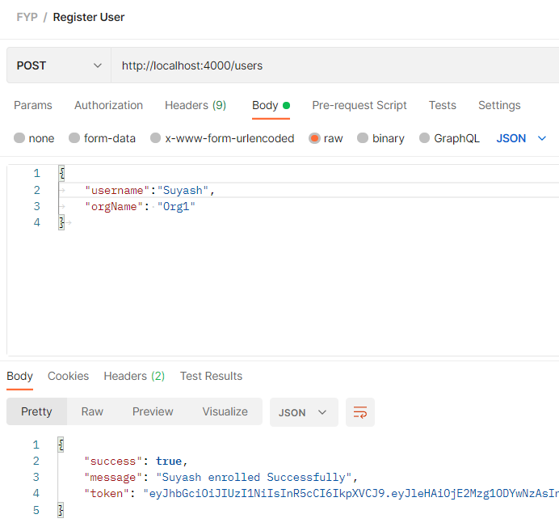
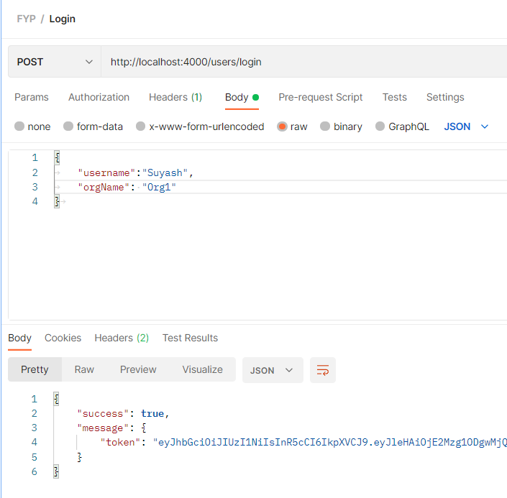
New peer is signed up for an org
Logging in using the credentials created
Registering and Logging a Peer to CA

Slide 8
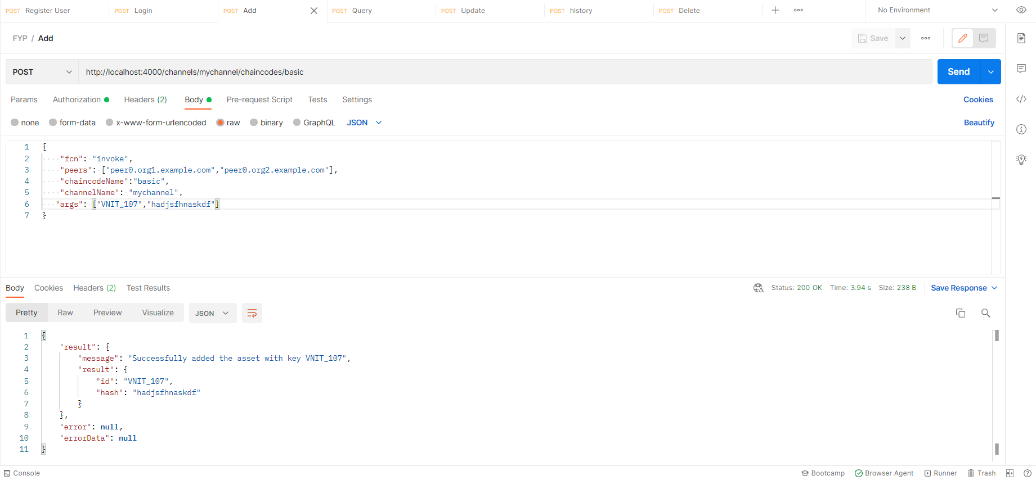
fcn: the function to be invoked
args: provide input parameters for the respective args
Creating Asset

Slide 9
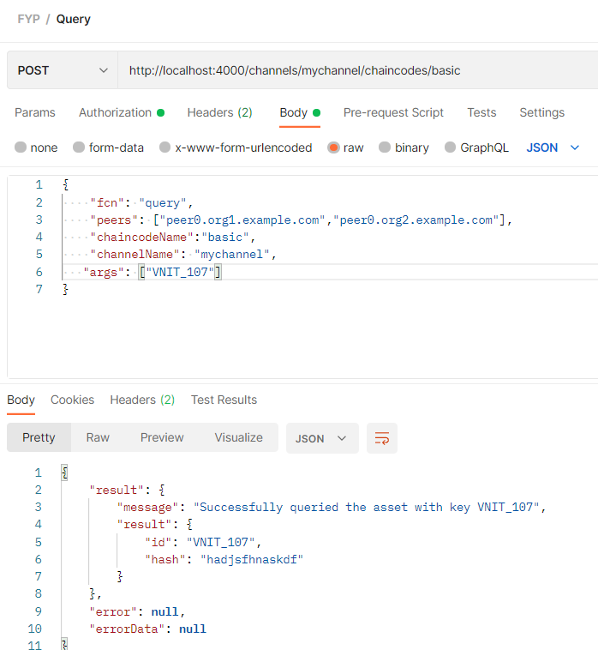
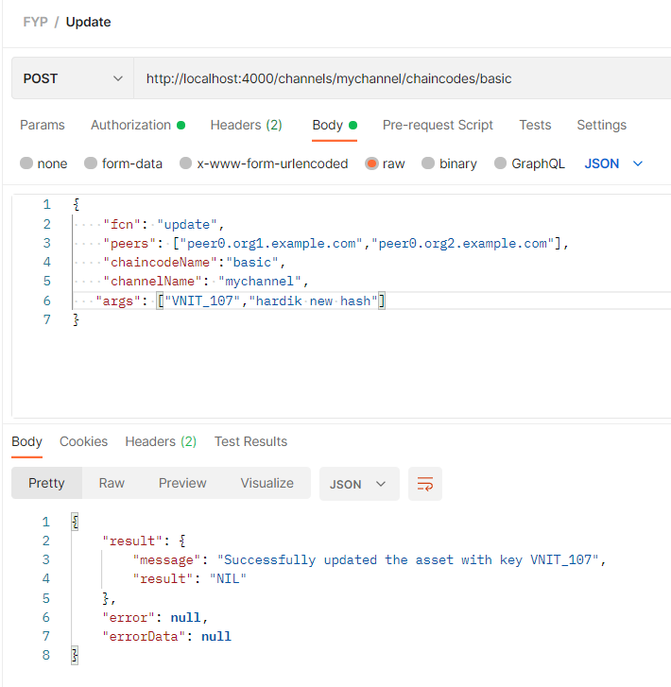
Query and Update Asset

Slide 10
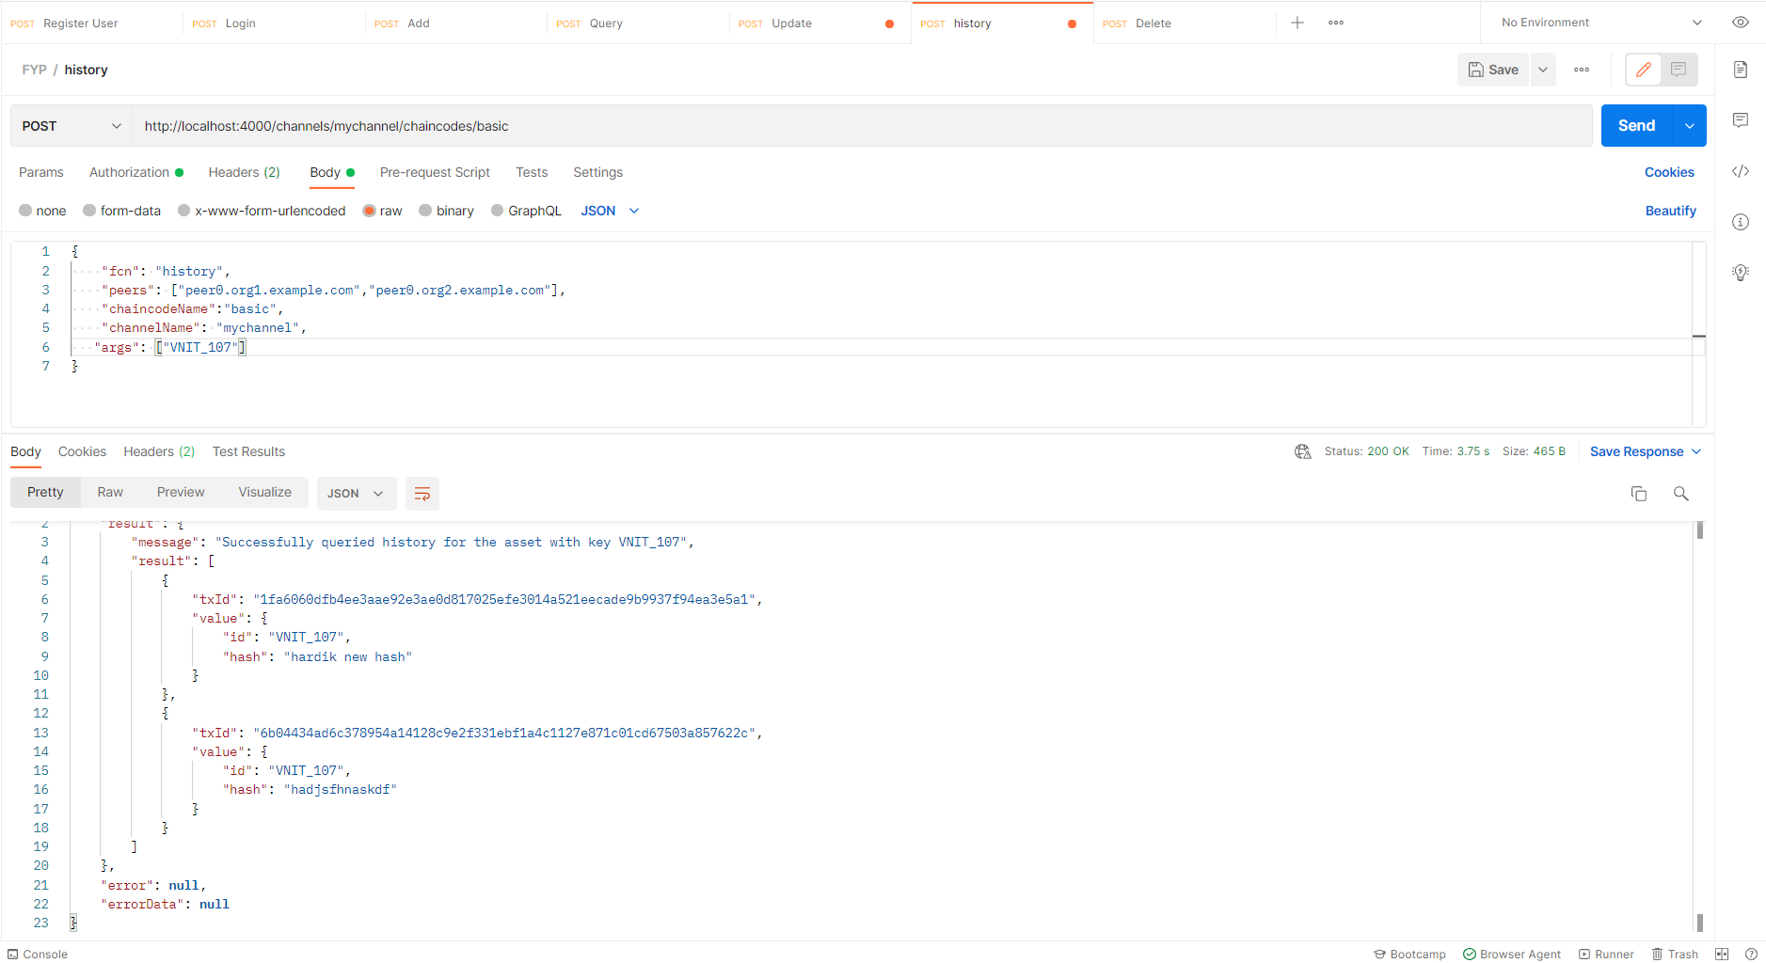
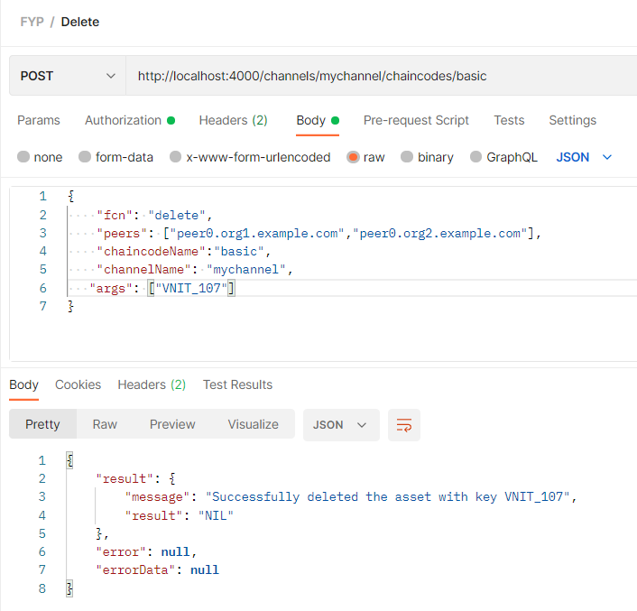
To delete the asset for a given id
To print the history of all the updates and additions done by a user in that
Get History and Delete

Slide 11
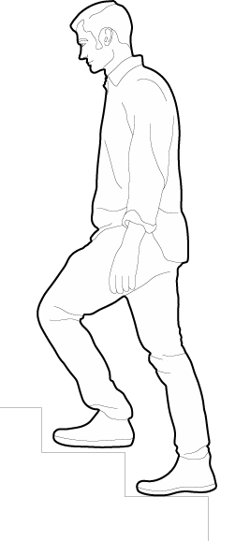





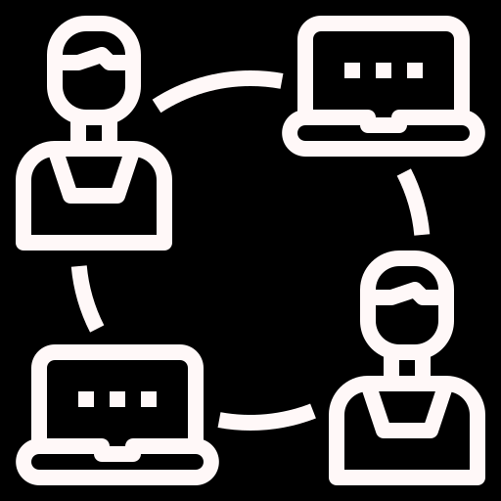
Challenges
Lack of updated tutorials
Difficult to modify channel participants
API security
Testing of chaincode
Remote collaboration
Challenges Faced
Malicious smart Contracts
Notes:
Remote collaboration: Difficult to build blockchain apps on local devices in a group project as collaboration and updation of code becomes difficult. Used Azure virtual machines to tackle this problem.
Testing of chaincode: Erroneous chaincode requires you to destroy complete network and recreate it which is time and resource consuming. To tackle this we used dev mode provided by hyperledger fabric which allowed us to install chaincode only on 1 node and a default test network was provided.
API security: Using JWT (JSON Web Token) to authorize a user. JWTs can be signed using a secret or a public/private key pair. Once a user is logged in, each subsequent request will require the JWT, allowing the user to access routes, services, and resources that are permitted with that token. JWTs are used as an alternative to session/cookies, allowing users to be authorized across multiple servers. Tokens are stored on the client-side while the session uses the server memory to store user data, and this might be an issue when a large number of users are accessing the application at once.
Difficult to dynamically modify channel configs or add new organizations and peers.
Due to lack of updated resources on hyperledger fabric, a lot of time was spent handling errors while building our network.

Slide 12

Future Goals
Dynamic shell scripts for hyperledger operations
Robust chaincode along with handling corner cases
User endpoint to connect to the organisations or employers
Anonymous data sharing b/w employers and employees
Notes:
Writing scripts for dynamic addition of orgs and peers to the channel
Fine tune our chaincode and web interface to handle corner cases and exceptions
Create a mobile app where users can login and save their issued certificates locally
A step further would be to allow employers to put their requirements over our application to reach out to potential employees who would anonymously share their certificates with them provided the requirements match.
a) Automated sharing: Rigid selection of fields which will be used to issue certificates to employees. These fields will be later used by employers to specify their requirements for hiring new employees. Notification will be sent to only those users who meet the requirements.
b) Manual sharing: A new employer would post his requirements and users will have the option to apply for the new job by sharing their certificates without sharing their identity. It will require splitting data into 2 parts: identity + qualifications.

Slide 13
Milestones
Data Sharing and Privacy Preserving Solutions using blockchain
Finalize problem statement and check already existing models
Improve on the system and add some unique features.
Aug | Sep | Oct | Nov | Dec | Jan | Feb | Mar | Apr | May
Explored case studies like real estate market, ex-employee traceability and import-export
Develop a basic system covering base functionality of problem.
Write research paper

Slide 14
Thank You

